Slide 1

REDUCING ALCOHOL DISORDER IN ADOLESCENTS
A parent based intervention to reduce alcohol use amongst adolescents residing in Scotland
Cas Huisman
B00376757
Psychology of Addictive Behaviour

Slide 2
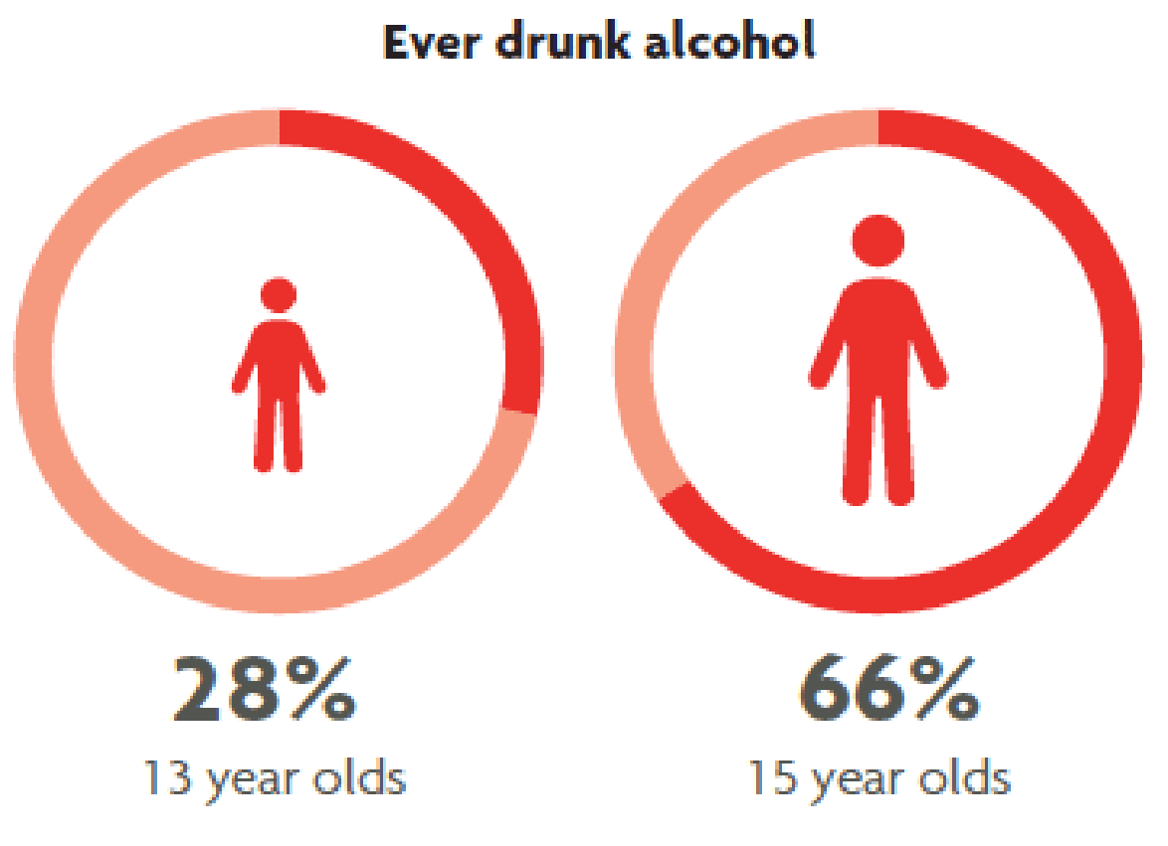
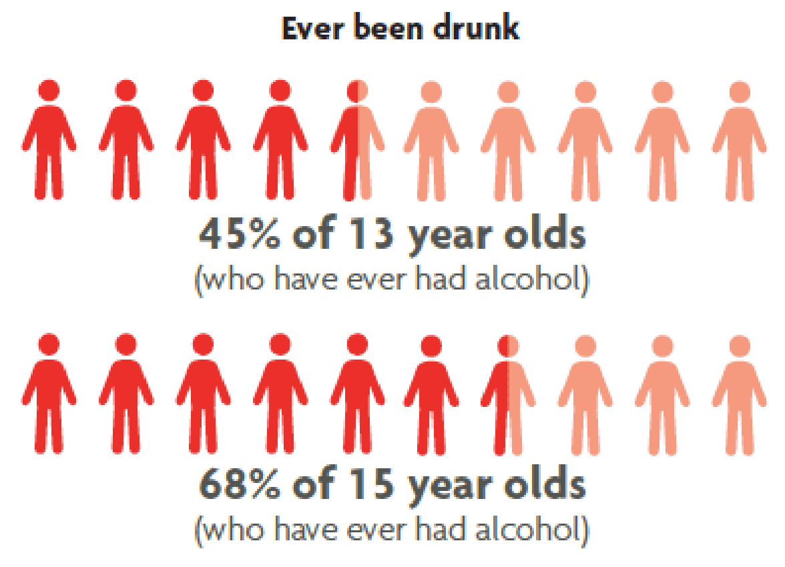
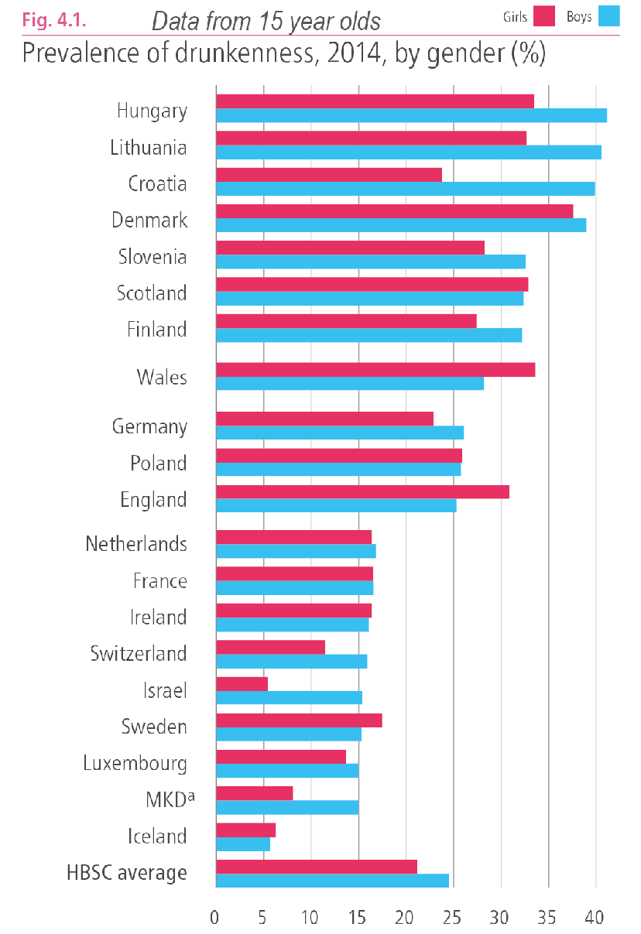
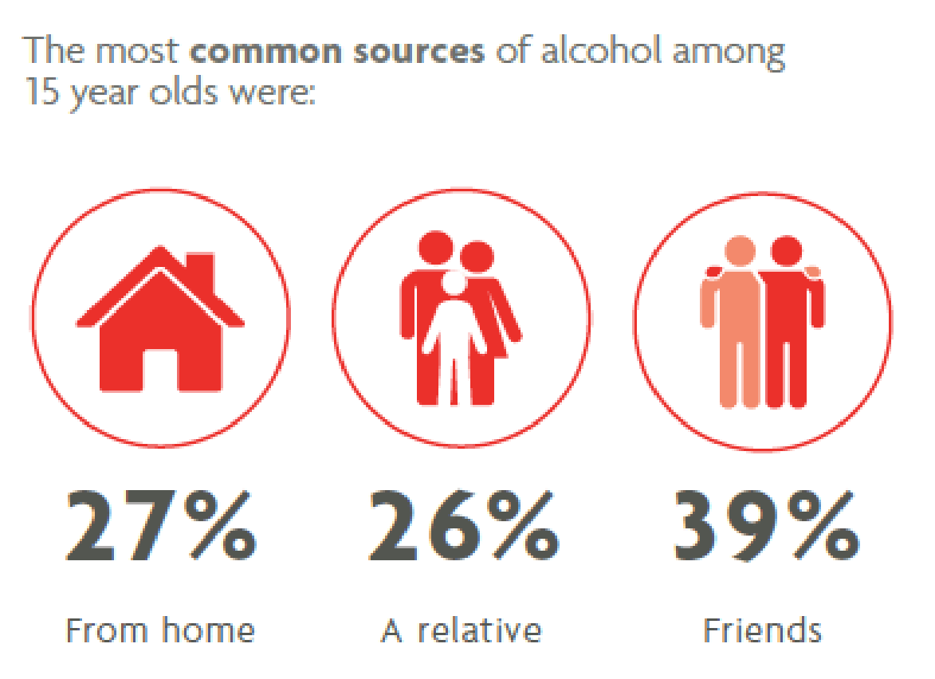
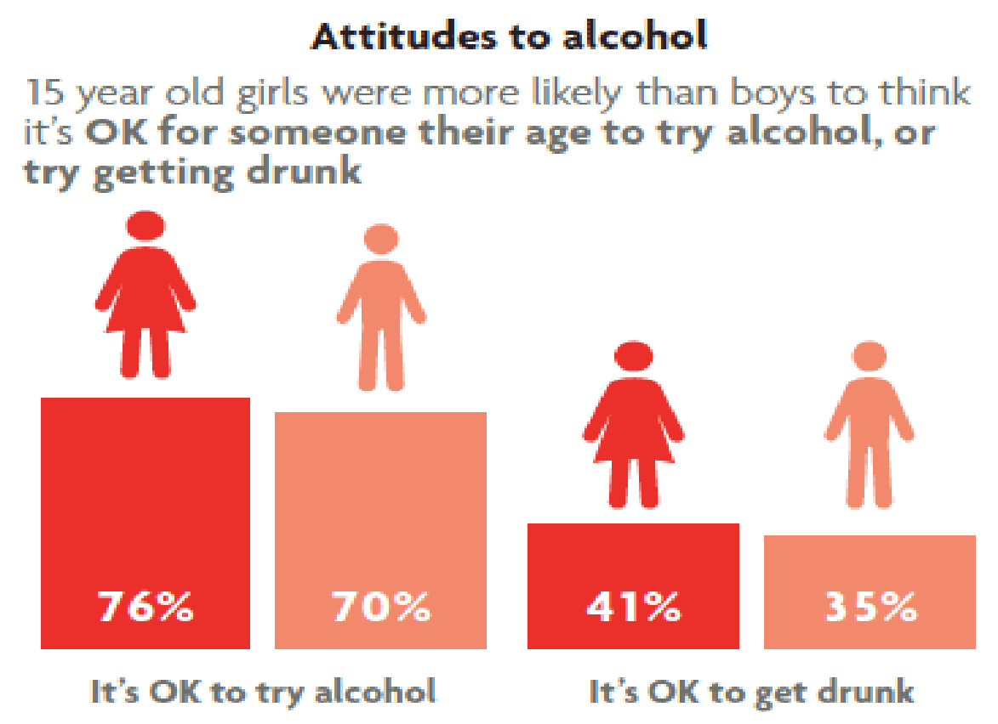
Adolescent alcohol use in Scotland
Alcohol misuse is estimated to cost the Scottish society between £2.5 million and £4.6 million per year
SALSUS (2016), HBSC (2016), Scottish Government (2008)

Slide 3
Adolescent alcohol use in Scotland
Risks include
Physical risks (Maldonado-Molina, Reingle, Tobler, & Komro, 2010; Perkins, 2002; SHAAP, 2014; Swahn, Bossarte, Ashby, & Meyers, 2010)
Mental health problems (Bava, & Tapert, 2010; Boden, Fergusson, 2014; Clark, Thatcher, & Tapert, 2008; Marshall, 2014; Spear, 2018; Welch, Carson, & Lawrie, 2013)
Increased chance of alcohol dependence later in life (Grant, & Dawson, 1997; Swendsen et al., 2009)
Behavioural problems (Komro, Tobler, Maldonado-Molina, & Perry, 2010; Luk et al., 2016; Perkins, 2002)
  Risky sexual behaviour (Mason et al., 2010)
The younger an adolescent starts drinking, the more severe the consequences. (Flory, Lynam, Milich, Leukefeld, & Clayton, 2004)

Slide 4
Factors causing adolescent alcohol use
Many factors found to play a role in delay of alcohol initiation
Social (Guo, Hawkins, Hill, & Abbott, 2001; Power, Stewart, Hughes, & Arbona 2005; Swaim, 1991; Walls, Fairlie, & Wood, 2009)
Cognitive (Guo et al., 2001)
Genetic (Derringer, Krueger, Mcgue, & Lacono, 2008)
Physical/mental illness (Power et al., 2005)
Environmental: (Guo et al., 2001; Kuntsche, & Kuntsche, 2016; Power et al., 2005; Ryan et al., 2011; Ryan, Jorm, & Lubman, 2010; Swaim, 1991; Turrisi, & Ray, 2010; Turrisi, Jaccard, Taki, Dunnam, & Grimes, 2001; Walls, Fairlie, & Wood, 2009; Yap, Cheong, Zaravinos, Lubman, & Jorm, 2017)
  Parent modelling
  Limiting availability of alcohol
  Parental monitoring
  Parent-child relationship

Slide 5
Parent based intervention
Existing methods (Gilligan, Kypri, & Lubman, 2012; Kuntsche, & Kuntsche, 2016)
  Parenting guidelines for Adolescent Alcohol Use (Gilligan, Kypri, 2012; Parenting Strategies Program, 2010; Ryan et al., 2011; Ryan, Jorm, & Lubman, 2010)
  Örebro Prevention Program (OPP) (Koutakis, Stattin, & Kerr, 2008)
  Parent Based Intervention (PBI) (Ainbinder, Bissett, Riedel, Turrisi, & Ray, 2008; Turrisi, Abar, Mallett, & Jaccard, 2010; Turrisi, & Ray, 2010)
  Familias Unidas (Prado et al., 2012)
  Steps Towards Alcohol Misuse Prevention Program (STAMPP) (McKay et al., 2018)

Slide 6
Parent based intervention
Evaluating current methods (Donovan et al., 2012; Gilligan, & Kypri, 2012; Turrisi, & Ray, 2010; Turrisi, Jaccard, Taki, Dunnam, & Grimes, 2001; Koutakis et al., 2008; Petrie, Bunn, & Byrne, 2007; Hayes, Smart, Toumbourou, & Sanson, 2004; Yap et al., 2017; Nash, McQueen, & Bray, 2005; National Institute on Alcohol Abuse and Alcoholism, 2006; Kuntsche, & Kuntsche, 2019; Foxcroft, & Tsertsvadze, 2011; Smit, Verdurmen, Monshouwer, & Smit, 2008)
What works
  Intensity of program
  Developmentally appropriate
  Rule setting on underage substance use
  Parental monitoring
  Improved parent-child communication
  Negative parent attitudes
Limitations
  Communicating program to parents
  Only in subgroups
  Low adherence to program
  Parents’ belief of inevitability
  No long-term evidence

Slide 7
Parent based intervention
Suggested method (Kuntsche, & Kuntsche, 2019; Turrisi, & Ray, 2010)
School meeting for parents at the start of the second year of secondary education (Hayes et al., 2004)
Show relevance of the issue and that parents play a role in adolescent alcohol use (Koutakis et al., 2008)
Give evidence-based guidelines what parents can do at home (Guo et al., 2001; Hayes et al., 2004; Nash et al., 2005; NIAAA, 2006; Ryan et al., 2011; Ryan et al., 2010; Swaim, 1991; Parenting Strategies Program, 2010; Power et al., 2005; Koutakis et al., 2008;; Yap et al., 2017)
  Parental monitoring
  Rule setting
  Parent-child communication
  Parent modelling
Follow up with personalised letters and email (Ainbinder et al., 2008; Dijkstra, 2008)

Slide 8
Parent based intervention
Effectiveness
In line with social learning theory as well as others (Kuntsche, & Kuntsche, 2019, Bandura, 1986; Bronfenbrenner, 1979; Oetting, & Donnermeyer, 1998)
Based on existing, working evidence-based methods
Parents are motivated to help their children (American College of Health Association, 2005; Dusenbury, 2000; Mallett, Varvil-Weld, Turrisi, & Read, 2011; Wood, Read, Mitchell, & Brand, 2004)
Evidence uses Western samples and a Scottish study, likely generalisable to Scotland

Slide 9
Parent based intervention
Limitations (Gilligan, & Kypri, 2012; Smit et al., 2008)
Uncertainty about the long-term effectiveness
Hard to attract and retain parents in high-risk families
May still only work in subgroups
Possibly low adherence to program and guidelines

Slide 10
Conclusions
High adolescent alcohol use in Scotland
Environmental causes affect everyone
New intervention based on existing parent based interventions
Focus on four guidelines
Reaches most parents and adolescents

Slide 11
References
Ainbinder, D., Bissett, D., Riedel, R., Turrisi, R., Ray, A. (2008). Does stressing parental limits on alcohol consumption reduce binge drinking in college students?. Paper presented at the Annual Meeting of the Rocky Mountain Psychological Association; Boise, ID.
American College of Health Association. (2005). The American College Health Association National College Health Assessment (ACHA-NCHA), spring 2003 reference group report. Journal of American College Health, 53 (5) (2005), pp. 199-210
Baer, J. S., Kivlahan, D. R., Blume, A. W., McKnight, P., & Marlatt, G. A. (2001). Brief intervention for heavy-drinking college students: 4-year follow-up and natural history. American Journal of Public Health, 91(8), 1310–1316. https://doi-org.proxy -ub.rug.nl/10.2105/AJPH.91.8.1310
Bava, S., & Tapert, S. F. (2010). Adolescent brain development and the risk for alcohol and other drug problems. Neuropsychology Review, 20(4), 398–413. https://doi-org.proxy-ub.rug.nl/10.1007/s11065-010-9146-6
Bandura, A. (1986). Social foundations of thought and action: A social cognitive theory. Englewood Cliffs, NJ: Prentice-Hall, Inc. Retrieved from http://search.ebscohost.com.proxy-ub.rug.nl/login.aspx?direct=true&db=psyh&AN=1985-98423-000&site=ehost -live&scope=site
Black, C., Setterfield, L., Murray, L. (Eds.) (2016). Scottish Schools Adolescent Lifestyle and Substance Use Survey (SALSUS): Alcohol Report 2015.
Boden, J. M. and Fergusson, D. M. (2014). The Short‐ and Long‐Term Consequences of Adolescent Alcohol Use. In Young People and Alcohol (eds J. B. Saunders and J. M. Rey). doi:10.1002/9781118785089.ch3
Bronfenbrenner, U. (1979). The ecology of human development: Experiments by nature and design. Cambridge, MA: Harvard University Press.
Clark, D. B., Thatcher, D. L., & Tapert, S. F. (2008). Alcohol, psychological dysregulation, and adolescent brain development. Alcoholism: Clinical and Experimental Research, 32(3), 375–385. https://doi-org.proxy-ub.rug.nl/10.1111/j.1530-0277.2007.00601.x
Derringer, J., Krueger, R. F., Mcgue, M., Lacono, W. G. (2008). Genetic and environmental contributions to the diversity of substances used in adolescent twins: a longitudinal study of age and sex effects. Addiction, 103, 1744–51

Slide 12
References
Dijkstra, A. (2008). The Psychology of Tailoring‐Ingredients in Computer‐Tailored Persuasion. Social and Personality Psychology Compass, 2, 765-784. 10.1111/j.1751-9004.2008.00081.x.
Donovan, E., Wood, M., Frayjo, K., Black, R. A., & Surette, D. A. (2012). A randomized, controlled trial to test the efficacy of an online, parent -based intervention for reducing the risks associated with college-student alcohol use. Addictive Behaviors, 37(1), 25–35. https://doi-org.proxy-ub.rug.nl/10.1016/j.addbeh.2011.09.007
Dusenbury, L. (2000). Family-based drug abuse prevention programs: A review. The Journal of Primary Prevention, 20(4), 337–352. https://doi-org.proxy-ub.rug.nl/10.1023/A:1021366721649
Flory, K., Lynam, D., Milich, R., Leukefeld, C., & Clayton, R. (2004). Early adolescent through young adult alcohol and marijuana use trajectories: Early predictors, young adult outcomes, and predictive utility. Development and Psychopathology, 16(1), 193–213. https://doi-org.proxy-ub.rug.nl/10.1017/S0954579404044475
Foxcroft, D. & Tsertsvadze, A. (2011). Universal family-based prevention programs for alcohol misuse in young people. Cochrane database o systematic reviews (Online). 9. CD009308. 10.1002/14651858.CD009308.
Gilligan, C., Kypri, K. (2012). Parent attitudes, family dynamics and adolescent drinking: qualitative study of the Australian parenting guidelines for adolescent alcohol use. BMC Public Health, 12, 491. doi:10.1186/1471-2458-12-491
Gilligan, C., Kypri, K., & Lubman, D. (2012). Changing parental behaviour to reduce risky drinking among adolescents: Current evidence and future directions. Alcohol and Alcoholism, 47(3), 349–354. https://doi-org.proxy-ub.rug.nl/10.1093/alcalc/ags022
Grant, B. F., & Dawson, D. A. (1997). Age at onset of alcohol use and its association with DSM-IV alcohol abuse and dependence: Results from the National longitudinal alcohol epidemiologic survey. Journal of Substance Abuse, 9, 103–110. https://doi-org.proxy -ub.rug.nl/10.1016/S0899-3289(97)90009-2
Guo, J., Hawkins, J. D., Hill, K. G., & Abbott, R. D. (2001). Childhood and adolescent predictors of alcohol abuse and dependence in young adulthood. Journal of studies on alcohol, 62(6), 754–762. doi:10.15288/jsa.2001.62.754
Hayes, L., Smart, D., Toumbourou, J. W., & Sanson, A. (2004). Parenting Influences on Adolescent Alcohol Use. Melbourne: Australian Institute of Family Studies

Slide 13
References
Inchley, J., Currie, D., Vieno, A., Torsheim, T., Ferreira-Borges, C., Weber, M., Barnekow, V., & Breda, J. (Eds.). (2018). Adolescent alcohol -related behaviours: trends and inequalities in the WHO European Region, 2002–2014. Observations from the Health Behaviour In School-aged Children (HBSC) WHO collaborative cross-national study. Copenhagen, WHO Regional Office for Europe
Komro, K. A., Tobler, A. L., Maldonado-Molina, M. M., & Perry, C. L. (2010). Effects of alcohol use initiation patterns on high-risk behaviors among urban, low-income, young adolescents. Prevention Science, 11(1), 14–23. https://doi-org.proxy-ub.rug.nl/10.1007/s11121 -009-0144-y
Koutakis, N., Stattin, H., & Kerr, M. (2008). Reducing youth alcohol drinking through a parent-targeted intervention: The Örebro Prevention Program. Addiction, 103(10), 1629–1637. https://doi-org.proxy-ub.rug.nl/10.1111/j.1360-0443.2008.02326.x
Kuntsche, S., & Kuntsche, E. (2016). Parent-based interventions for preventing or reducing adolescent substance use—A systematic literature review. Clinical Psychology Review, 45, 89–101. https://doi-org.proxy-ub.rug.nl/10.1016/j.cpr.2016.02.004
Luk, J. W., Worley, M. J., Winiger, E., Trim, R. S., Hopfer, C. J., Hewitt, J. K., Brown, S. A., Wall, T. L. (2016). Risky driving and sexual behaviors as developmental outcomes of co-occurring substance use and antisocial behavior. Drug and alcohol dependence, 169, 19–25. doi:10.1016/j.drugalcdep.2016.10.006
Maldonado-Molina, M. M., Reingle, J. M., Tobler, A. L., & Komro, K. A. (2010). Effects of beverage-specific alcohol consumption on drinking behaviors among urban youth. Journal of Drug Education, 40(3), 265–280. https://doi-org.proxy-ub.rug.nl/10.2190/DE.40.3.d
Mallett, K. A., Varvil-Weld, L., Turrisi, R., & Read, A. (2011). An examination of college students’ willingness to experience consequences as a unique predictor of alcohol problems. Psychology of Addictive Behaviors, 25(1), 41–47. https://doi-org.proxy -ub.rug.nl/10.1037/a0021494
Marshall, E. J. (2014). Adolescent alcohol use: Risks and consequences. Alcohol and Alcoholism, 49(2), 160–164. https://doi-org.proxy -ub.rug.nl/10.1093/alcalc/agt180
Mason, W. A., Hitch, J. E., Kosterman, R., McCarty, C. A., Herrenkohl, T. I., & Hawkins, J. D. (2010). Growth in adolescent delinquency and alcohol use in relation to young adult crime, alcohol use disorders, and risky sex: A comparison of youth from low-versus middle -income backgrounds. Journal of Child Psychology and Psychiatry, 51(12), 1377–1385. https://doi-org.proxy -ub.rug.nl/10.1111/j.1469-7610.2010.02292.x

Slide 14
References
McKay, M., Agus, A., Cole, J., Doherty, P., Foxcroft, D., Harvey, S., Murphy, L., Percy, A., Sumnall, H. (2018). Steps Towards Alcohol Misuse Prevention Programme (STAMPP): a school-based and community-based cluster randomised controlled trial. BMJ open, 8(3), e019722. doi:10.1136/bmjopen-2017-019722
National Institute on Alcohol Abuse and Alcoholism (NIAAA). (2006). Underage Drinking: Why Do Adolescents Drink, What Are the Risks, and How Can Underage Drinking Be Prevented?. Alcohol Alert, 67. Retrieved from https://pubs.niaaa.nih.gov/publications/AA67/AA67.htm
Nash, S. G., McQueen, A., & Bray, J. H. (2005). Pathways to adolescent alcohol use: Family environment, peer influence, and parental expectations. Journal of Adolescent Health, 37(1), 19–28. https://doi-org.proxyub.rug.nl/10.1016/j.jadohealth.2004.06.004
Oetting, E. R., & Donnermeyer, J. F. (1998). Primary socialization theory: The etiology of drug use and deviance I. Substance Use & Misuse, 33(4), 995–1026. https://doi-org.proxy-ub.rug.nl/10.3109/10826089809056252
Parenting Strategies Program (2010). Parenting Guidelines for Adolescent Alcohol Use. Melbourne: Orygen Youth Health Research Centre, University of Melbourne
Perkins, H. W. (2002). Surveying the damage: a review of research on consequences of alcohol misuse in collage populations. Journal of Studies on Alcohol, Supplement, 14, 91–100.
Petrie, J., Bunn, F., & Byrne, G. (2007). Parenting programmes for preventing tobacco, alcohol or drugs misuse in children &lt;18: A systematic review. Health Education Research, 22(2), 177–191. https://doi-org.proxy-ub.rug.nl/10.1093/her/cyl061
Pettersson, C., Ozdemir, M., & Eriksson, C. (2011). Effects of a parental program for preventing underage drinking - The NGO program strong and clear. BMC Public Health, 11 ,251. http://dx.doi.org/10.1186/1471-2458-11-251
Power, T. G., Stewart, C. D., Hughes, S. O., & Arbona, C. (2005). Predicting Patterns of Adolescent Alcohol Use: A Longitudinal Study. Journal of Studies on Alcohol, 66(1), 74–81. https://doi-org.proxy-ub.rug.nl/10.15288/jsa.2005.66.74
Prado, G., Cordova, D., Huang, S., Estrada, Y., Rosen, A., Bacio, G. A., Guadalupe A. Jimenez, G. L., Pantin, H., Brown, C. H., Velazquez, M., Villamar, J., Freitas, D., Tapia, M. I., & McCollister, K. (2012). The efficacy of Familias Unidas on drug and alcohol outcomes for Hispanic delinquent youth: Main effects and interaction effects by parental stress and social support. Drug and Alcohol Dependence, 125(Suppl 1), S18–S25. https://doi-org.proxy-ub.rug.nl/10.1016/j.drugalcdep.2012.06.011

Slide 15
References
Ryan, S. M., Jorm, A. F., Kelly, C., Hart, L., Morgan, A., & Lubman, D. I. (2011). Parenting strategies for reducing adolescent alcohol use: A Delphi consensus study. BMC public health, 11, 13. 10.1186/1471-2458-11-13.
Ryan, S. M., Jorm, A. F., & Lubman, D. I. (2010). Parenting factors associated with reduced adolescent alcohol use: A systematic review of longitudinal studies. Australian and New Zealand Journal of Psychiatry, 44(9), 774–783. https://doi-org.proxy -ub.rug.nl/10.1080/00048674.2010.501759
Scottish Government. (2008). Changing Scotland’s relationship with alcohol: a discussion paper on our strategic approach.
Scottish Health Action on Alcohol Problems (SHAAP). (2019). Alcohol and Cancer Risks A Guide for Health Professionals.
Smit, E., Verdurmen, J., Monshouwer, K., & Smit, F. (2008). Family interventions and their effect on adolescent alcohol use in general populations: A meta-analysis of randomized controlled trials. Drug and Alcohol Dependence, 97(3), 195–206. https://doi-org.proxy -ub.rug.nl/10.1016/j.drugalcdep.2008.03.032
Spear, L. P. (2018). “Effects of adolescent alcohol consumption on the brain and behaviour”: Author Correction. Nature Reviews Neuroscience, 19(4). Retrieved from http://search.ebscohost.com.proxy-ub.rug.nl/login.aspx?direct=true&db=psyh&AN=2018 -44932-008&site=ehost-live&scope=site
Swahn, M. H., Bossarte, R. M., Ashby, J. S., & Meyers, J. (2010). Pre-teen alcohol use initiation and suicide attempts among middle and high school students: Findings from the 2006 Georgia student health survey. Addictive Behaviors, 35(5), 452–458. https://doi-org.proxy -ub.rug.nl/10.1016/j.addbeh.2009.12.017
Swaim, R. C. (1991). Childhood risk factors and adolescent drug and alcohol abuse. Educational Psychology Review, 3(4), 363–398. https://doi -org.proxy-ub.rug.nl/10.1007/BF01319937
Swendsen, J., Conway, K. P., Degenhardt, L., Dierker, L., Glantz, M., Jin, R., Merikangas, K. R., Sampson, N., & Kessler, R.C. (2009). Socio‐demographic risk factors for alcohol and drug dependence: the 10‐year follow‐up of the national comorbidity survey. Addiction, 104. 1346-1355. doi:10.1111/j.1360-0443.2009.02622.x

Slide 16
References
Turrisi, R., Abar, C., Mallett, K. A., & Jaccard, J. (2010). An examination of the mediational effects of cognitive and attitudinal factors of a parent intervention to reduce college drinking. Journal of Applied Social Psychology, 40(10), 2500–2526. https://doi-org.proxy -ub.rug.nl/10.1111/j.1559-1816.2010.00668.x
Turrisi, R., Jaccard, J., Taki, R., Dunnam, H., & Grimes, J. (2001). Examination of the short-term efficacy of a parent intervention to reduce college student drinking tendencies. Psychology of Addictive Behaviors, 15(4), 366–372. https://doi.org/10.1037/0893-164X.15.4.366
Turrisi, R., & Ray, A. E. (2010). Sustained parenting and college drinking in first-year students. Developmental Psychobiology, 52(3), 286–294. Retrieved from http://search.ebscohost.com.proxy-ub.rug.nl/login.aspx?direct=true&db=psyh&AN=2010-07169-010&site=ehost -live&scope=site
Walls, T. A., Fairlie, A. M., & Wood, M. D. (2009). Parents do matter: A longitudinal two-part mixed model of early college alcohol participation and intensity. Journal of Studies on Alcohol and Drugs, 70(6), 908–918. https://doi-org.proxy-ub.rug.nl/10.15288/jsad.2009.70.908
Welch, K. A., Carson, A., & Lawrie, S. M. (2013). Brain structure in adolescents and young adults with alcohol problems: Systematic review of imaging studies. Alcohol and Alcoholism, 48(4), 433–444. https://doi-org.proxy-ub.rug.nl/10.1093/alcalc/agt037
Wood, M. D., Read, J. P., Mitchell, R. E., & Brand, N. H. (2004). Do Parents Still Matter? Parent and Peer Influences on Alcohol Involvement Among Recent High School Graduates. Psychology of Addictive Behaviors, 18(1), 19–30. https://doi-org.proxy-ub.rug.nl/10.1037/0893 -164X.18.1.19
Yap, M. B. H., Cheong, T. W. K., Zaravinos, T. F., Lubman, D. I., & Jorm, A. F. (2017). Modifiable parenting factors associated with adolescent alcohol misuse: A systematic review and meta‐analysis of longitudinal studies. Addiction, 112(7), 1142–1162. https://doi-org.proxy -ub.rug.nl/10.1111/add.13785

