Slide 1
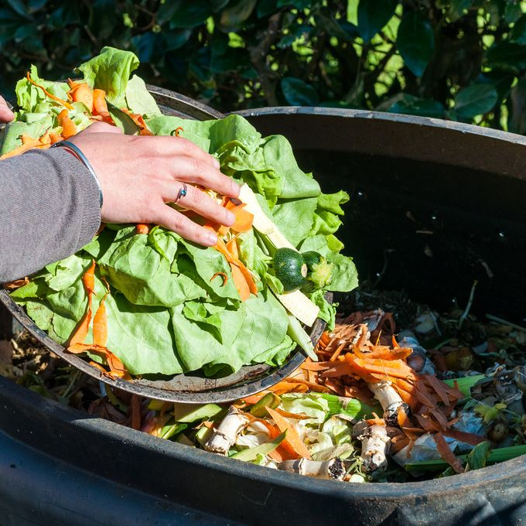



Stimulating pro-environmental behaviour maintenance through habit formation interventions
Habit formation in a food waste context
Notes:
Welcome
Excited to kick off this PhD day
Share what I have been up to for the past 6 months
Title “Stimulating pro-environmental behaviour maintenance through habit formation intervention”
First briefly talk about why

Slide 2
Contents
Introduction
Theoretical background
Study 1
And beyond
Notes:
Taking you through the following in 15-20 min presentation
Short intro on why habits and environmentally impactful behaviour
Theoretical background on habits
Research project, study 1
What comes after
10-15 min discussion
- Food waste reduction as a context to investigate pro-environmental behaviours

Slide 3
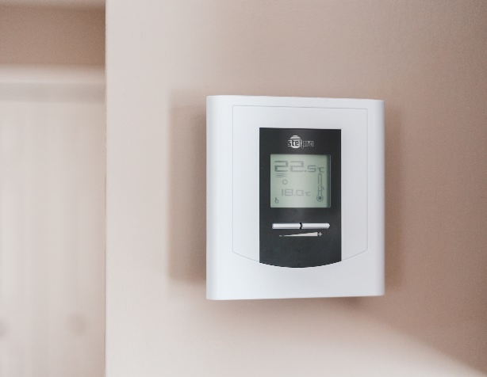

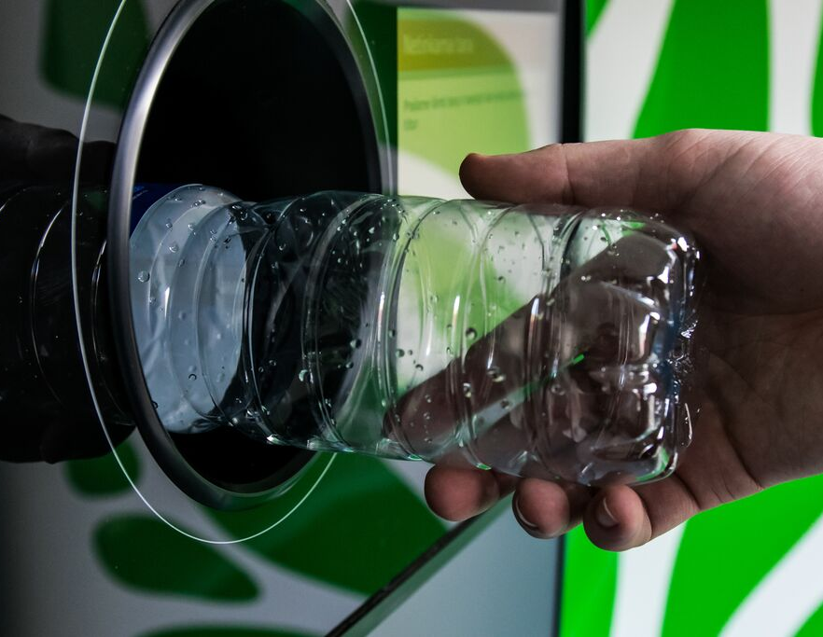

You turn on the heating everywhere when you are cold
You discard the leftovers into the bin before putting them in the dishwasher
You throw the drink can into the general waste or PMD when you finish it
You pick up your car keys when going out the door to work in the morning
Notes:
Many environmentally impactful behaviours happen very often
Turning on heating when you’re cold, and leaving it on when not needed
Discarding leftovers off your plates before putting them in the dishwasher
Throwing your drink can in the general waste (or PMD) when you finish it (reminder you can now hand them in at the supermarket and get some money back!)
Picking up your car keys as you go out the door to work in the morning
Other than being environmentally impactful, something else in common.
Cues!

Slide 4
You turn on the heating when you are cold
You discard the leftovers into the bin before putting them in the dishwasher
You throw the drink can into the general waste or PMD when you finish it
You pick up your car keys when going out the door to work in the morning
Notes:
Cues!
As shown here
This is important because of habits
As opposed to the common use of the word, definition is a whole lot more complicated

Slide 5

Defining habit
Habit is the process by which a context-response association, learned through repeated behavioural performance in a specific context, triggers an impulse to enact the associated response upon exposure to context cues.
Gardner et al., 2005
Not a behaviour
Automatic response to a cue
  Stimulus driven
  Goal independent
Route to behaviour maintenance
Notes:
Read out definition
So to unpack that
A habit is not a behaviour, but a process (because habits are said to be a determinant of behaviour, so it cannot be a behaviour)
It is an automatic response to a cue
Stimulus driven
Independent of intentions and goals
Example: you have always flossed after brushing teeth, now it happens automatically
Habits are one route to behaviour maintenance (what I want to achieve)

Slide 6
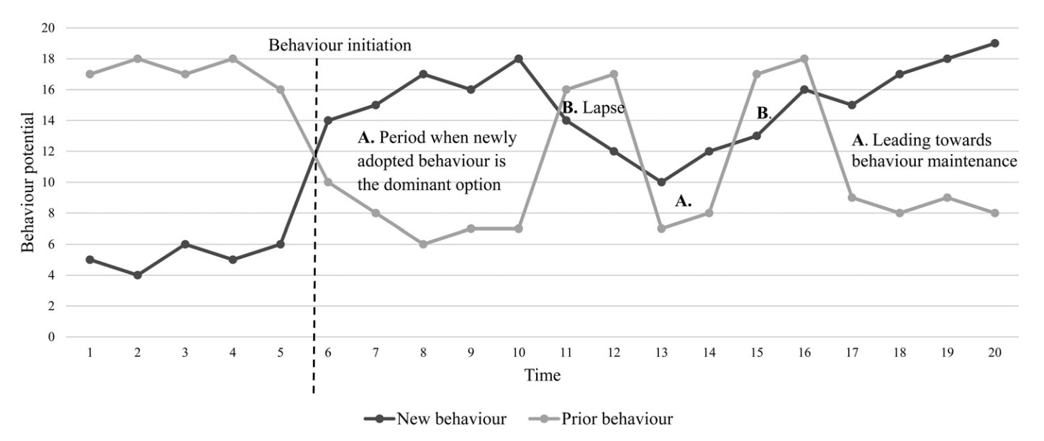
Behaviour maintenance
Kwasnicka et al., 2016
Notes:
Behaviour maintenance is a rocky road
Existing habits can be a barrier to behaviour change
Very inflexible
Outside of awareness
Effortful to override, “old habits die hard”
- Desirable features for pro-environmental behaviour to make them stick

Slide 7

Habit formation
Stage 1.
Intention formation
Stage 2.
Action initiation
Stage 3a.
Behaviour repetition
Stage 3b.
Habit formation
Initial Motivation
Self-regulation
Context-dependent repetition
Habit
Intention
Behaviour
Cue
Gardner & Lally, 2018; Gardner et al., 2020
Notes:
Understanding habit formation starts the same way any behaviour change process starts according to habit formation model by Gardner & Lally
Intention formation (motivation leads to an intention)
Action initiation (intention is translated into action
This first enactment of a new behaviour is the main aim of many interventions, but often it does not last
3. Behaviour repetition is a self-regulatory process of choosing to perform the behaviour again (likely because it achieved a desired outcome)
4. Habit formation happens when you continuously associate a cue with the behaviour performance (on average 66 days; mental association is established)
5. Need for goal achievement goes away
Main interest is in the last stages, behaviour repetition leading to habit formation.
- Develop interventions to facilitate this
But where to start? This is investigated mostly in health behaviour context
Study 1!
Gardner et al., 2020

Slide 8
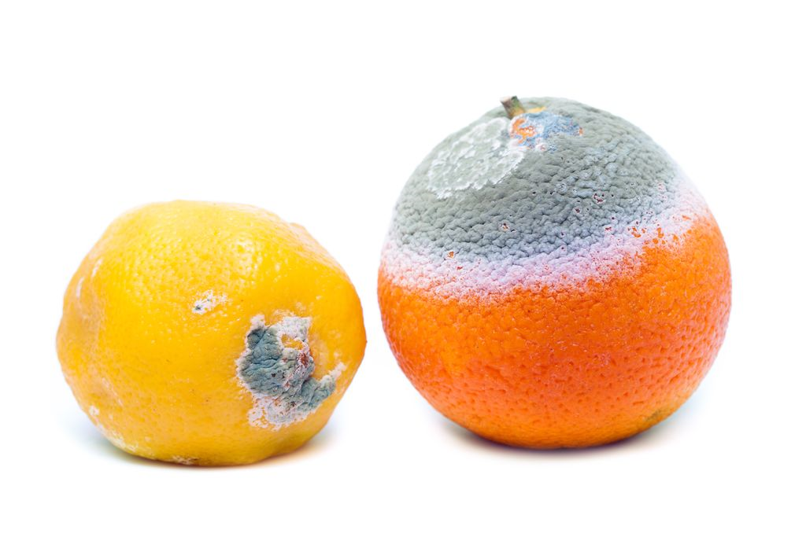
Study 1 – Understanding food waste habits
Food management context
Cross-sectional
Exploratory
Two parts
  1a: Rate all that apply list of food management behaviours
  1b: Determinants of habit strength and food waste
Notes:
Objective: Before testing interventions, know where to intervene and how
Preparation for serires of longitudinal intervention experiments
Find prevalence of habits
Likely to exist, food management happens every day in a stable context
2 part exploratory study,
1a: find which food management behaviours are habitual
1b: determinants of the habit strength of these behaviours

Slide 9
Study 1a – Rate all that apply
Prolific
Long list of food waste generating behaviours
Rate all that apply on their automaticity
Self-Report Behavioural Automaticity Index (Gardner et al., 2012)
Behaviours which are highly automatic for some but not others input for study 1b
Indicate whether you engage in the following behaviours
Planning:
I make a shopping list
Shopping:
I buy the same products when grocery shopping
Cooking:
Before cooking I always weigh my ingredients
This is something:
I do automatically
I do without having to consciously remember
I do without thinking
I start doing before I realize I’m doing it
Notes:
Prolific
Long list of behaviours from previous qualitative and quantitative research (as comprehensive as possible)
Rate all that they engage in
If so, rate SRBAI
Example (cooking)
Input for study 1b

Slide 10
Study 1b – Determinants of Habit Strength
ToNoWaste baseline measurement
Habit strength of behaviours from study 1a
Generated food waste
Possible determinants of habit strength
  COM-B
  Theoretical Domains Framework (TDF)
  Habit theory
Capability
Motivation
Behaviour
Opportunity
Notes:
Test of habit strength determinants
Measure habit strength
Measure food waste (to know whether the habits are related to more/less food waste)
Measure determinants
COM-B (broad framework, also has long term predictive validity)
TDF (make COM-B less abstract)
Habit Theory

Slide 11
TDF domains and COM-B
COM-B Component | TDF Domain
Psychological capability | Skills
 | Memory, attention and decision making
 | Knowledge
 | Behavioural Regulation
Physical Opportunity | Environmental context and resources
Social opportunity | Social influences
Reflective motivation | Social/professional role and identity
 | Beliefs about capabilities
 | Intentions
 | Goals
 | Beliefs about consequences
Automatic motivation | Emotion
 | Reinforcement
Notes:
TDF assigns constructs to each COM-B component
Does not matter which or where, just to show how it works

Slide 12
Model development
Self-regulation
Initial Motivation
Context-dependent repetition
Habit
Intention
Cue
Behaviour
Notes:
This is where I struggle
Have this habit formation model starting point, very abstract
Where do all my other components go?

Slide 13
Skills
Behaviour regulation
Environmental context and resources
Goals
Intentions
Emotion
Memory, attention, decision making
Beliefs about capabilities
Social/ Professional role and identity
Knowledge
Beliefs about consequences
Social Influences
Behavioural regulation
Reinforcement
Intention
Self-regulation
Context-dependent
repetition
Intrinsic reward
Habit strength
Anticipated regret
Self-efficacy
Notes:
Context-dependent repetition is a black box, I am not measuring a cue
Looking at at resulting habit strength
Starting point is when intention is formed
This leads to a first enactment of a behaviour I want to make habitual, so there is sort of a black box of context-dependent repetition where the behaviour is paired with a cue, but I do not know the cue.
I do know that this context-dependent repetition is going to create a habit, measured in habit strength
Habit formation model suggests repetition happens under influence of self-regulation
Previous intervention studies show a behaviour is more likely to become habituated if it is intrinsically rewarding
Mixed evidence if not performing the behaviour could lead to anticipated regret
And mixed evidence about the self-efficacy of the behaviour
Good start, then there are all of these I added

Slide 14
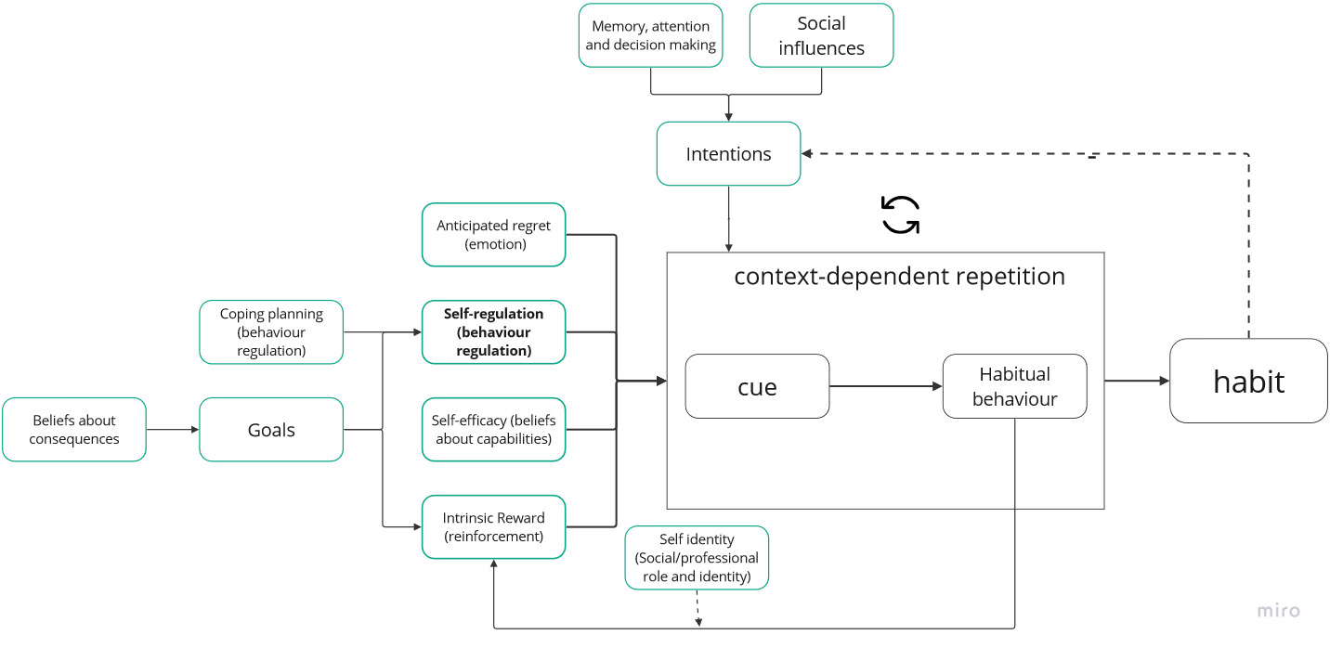
Notes:
I first made this, but there is little reason for it
I cannot test all the relationships like this
They are somewhat arbitrary
Struggling a bit with how to make this make sense
But that is the goal of study 1, to explore the relationships between many determinants and habit strength to know what determinants I can play with in interventions

Slide 15

Study 2 – Design of a habit formation intervention
Cooking workshop during AID
Collaboration with Foundation Together against food waste
Longitudinal experiments
Two parts:
  2a: Factorial experiment (AID)
  2b: Two-armed field experiment (ToNoWaste)
Flexible habit formation intervention
Notes:
During this same year I plan on starting my second study as well
Stichting Samen tegen voedselverspilling organising cooking workshops during AID focused on food waste
Run a longitudinal experiment
Two studies to design the intervention
My intervention follows an existing intervention focused on intention enactment, in theory does not matter what the prior intervention is, as long as it leads to intention enactment
Intervention is flexible, participants choose their own behaviour to focus on (more intrinsically rewarding), then make a plan to perform this behaviour
Intervention offers support in different ways to enact this action plan
Factorial design to test different ways of facilitating plan enactment and habit formation
Find a good combination of intervention components
Test in a field experiment as part of ToNoWaste

Slide 16

What comes after
Understanding habit formation for environmentally impactful behaviours
Know how to form new habits and substitute existing ones
Study 3
Study 4

Slide 17
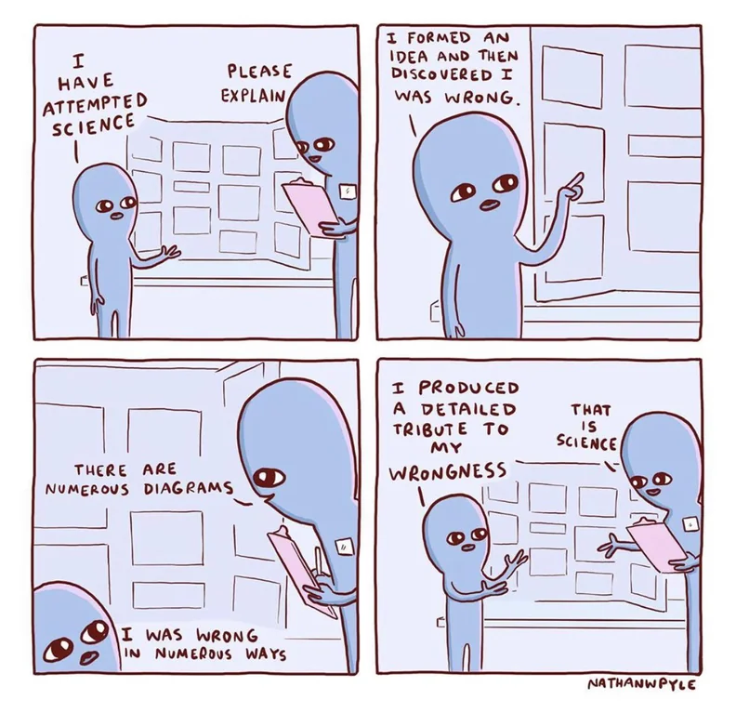
Thank you for your attention!

